Slide 1
UNIT 3

Slide 2

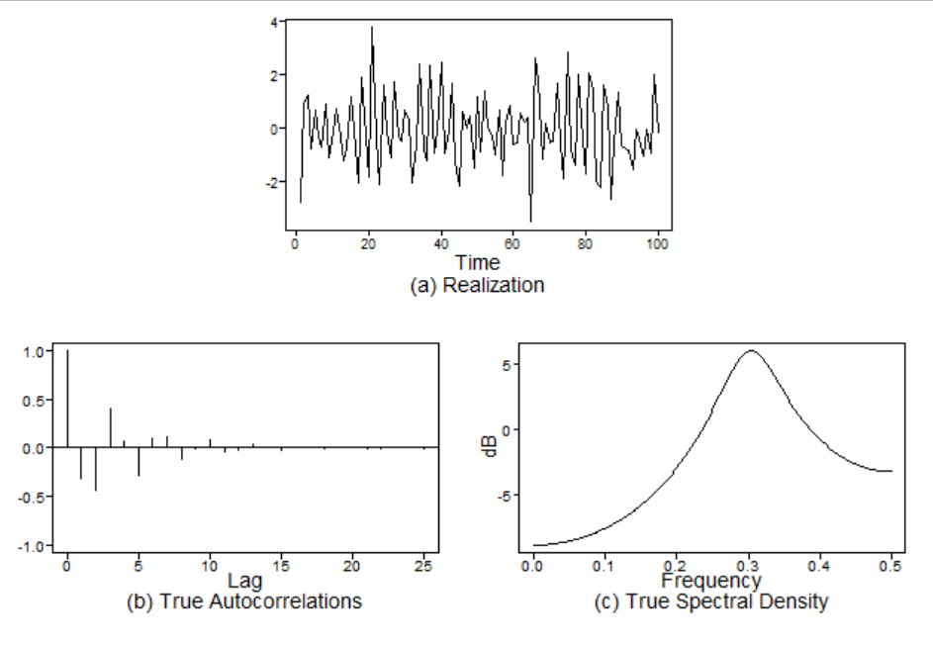
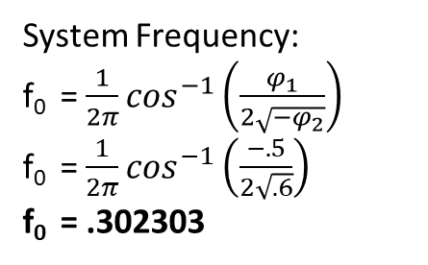
For Live Session – Activity 1
Operator Notation: (1 + .5B + .6B²)X_{t} = 0
Characteristic Equation: 1 + .5z + .6z² = 0
Roots: (1+.2z)(1+.3z)=0
r₁ = 1/-.2 = -5 r₂ = 1/-.3 = -3.333
Coefficients of Original polynomial:
-0.5000 -0.6000
Factor Roots Abs Recip System Freq
1+0.5000B+0.6000B^2 -0.4167+-1.2219i 0.7746 0.3023
System Frequency:
f₀ = $\frac{1}{2π}\cos^{−1}\left(\frac{φ_{1}}{2\sqrt{−φ_{2}}}\right)$
f₀ = $\frac{1}{2π}\cos^{−1}\left(\frac{−.5}{2\sqrt{.6}}\right)$
f₀ = .302303
Because the Absolute Reciprocal of the root is less than 1, the model is stationary

Slide 3
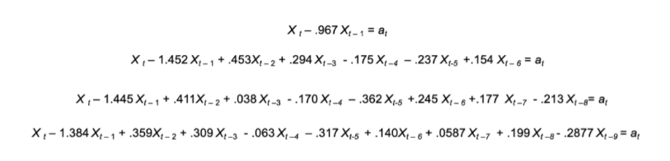
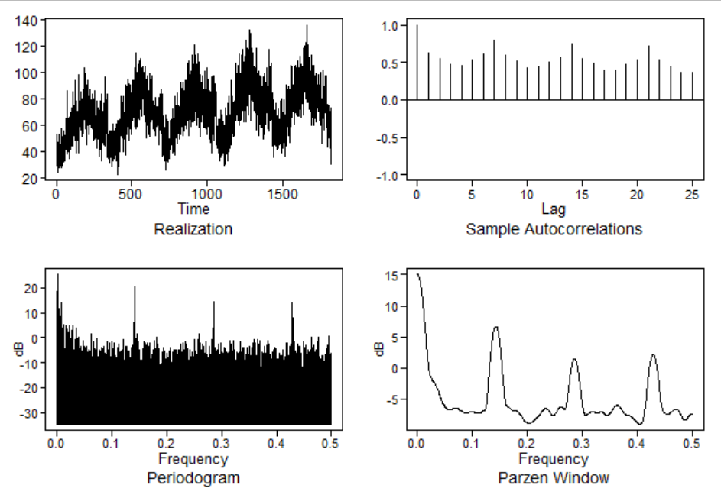
For Live Session – Activity 2

Slide 4
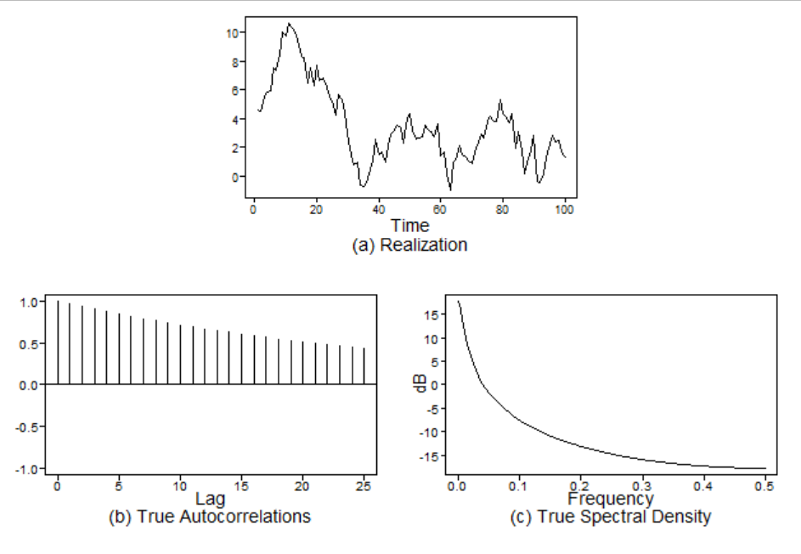
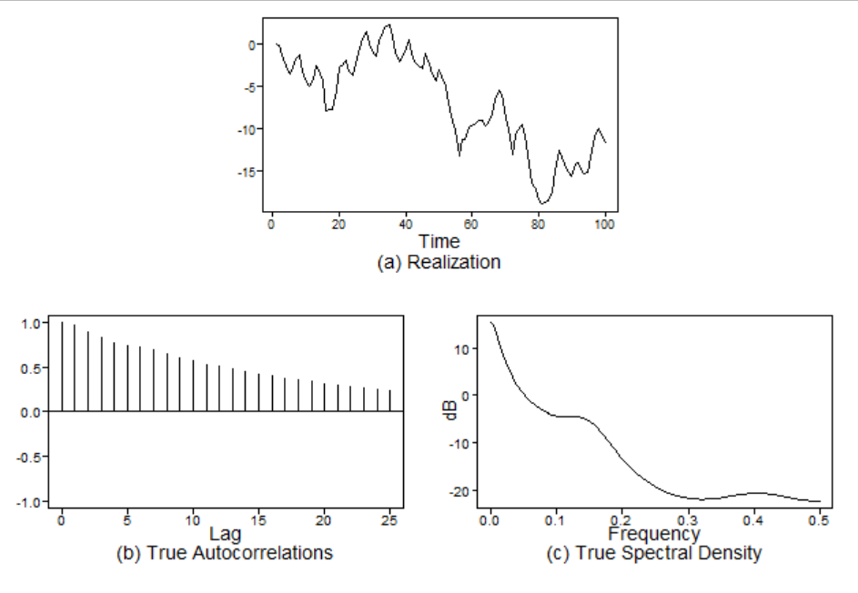
For Live Session – Activity 2
Model 1:
Model 2:
Coefficients of Original polynomial:
0.9670
Factor Roots Abs Recip System Freq
1-0.9670B 1.0341 0.9670 0.0000
Coefficients of Original polynomial:
1.4520 -0.4530 -0.2940 0.1750 0.2370 -0.1540
Factor Roots Abs Recip System Freq
1-0.9428B 1.0607 0.9428 0.0000
1-0.9484B+0.6428B^2 0.7377+-1.0057i 0.8017 0.1493
1+1.0620B+0.4080B^2 -1.3014+-0.8702i 0.6388 0.4062
1-0.6228B 1.6057 0.6228 0.0000

Slide 5
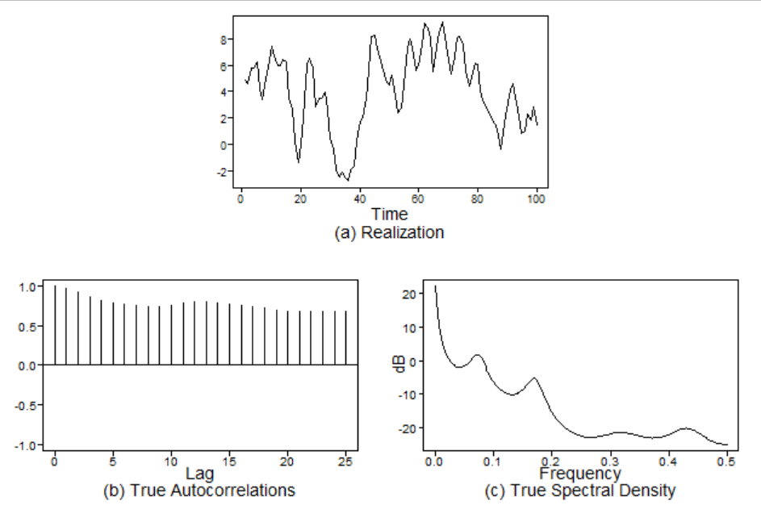
For Live Session – Activity 2
Model 3:
Model 4:
This model is not stationary because it contains an Absolute Reciprocal of Root greater than 1 (by a large amount as well)
Coefficients of Original polynomial:
1.4450 -0.4110 -0.0380 0.1700 0.3620 -0.2450 -0.1770 0.2130
Factor Roots Abs Recip System Freq
1-1.2456B 0.8028 1.2456 0.0000
1-0.6653B+0.8160B^2 0.4077+-1.0292i 0.9033 0.1900
1+1.0631B+0.6139B^2 -0.8658+-0.9376i 0.7835 0.3687
1-1.2609B+0.5144B^2 1.2257+-0.6647i 0.7172 0.0791
1+0.6636B -1.5069 0.6636 0.5000
Coefficients of Original polynomial:
1.3840 -0.3590 -0.3090 0.0630 0.3170 -0.1400 -0.0587 -0.1990 0.2877
Factor Roots Abs Recip System Freq
1-0.9898B 1.0103 0.9898 0.0000
1-0.8851B+0.8545B^2 0.5179+-0.9497i 0.9244 0.1705
1-1.6496B+0.8498B^2 0.9706+-0.4845i 0.9218 0.0737
1+1.4991B+0.6791B^2 -1.1037+-0.5044i 0.8241 0.4318
1+0.6415B+0.5894B^2 -0.5442+-1.1834i 0.7677 0.3186

Slide 6
Takeaways from Unit 3
Filters are sometimes used to “filter out” certain frequencies from a set of data. Two of these types of filters are:
Low-Pass Filters – Allow low-frequency behavior through but filters out high-frequency.
High-Pass Filters – Allow high-frequency behavior through but filters out low-frequency.
Difference filter – Helps to remove the trending behavior that is long-term and keeps only the periodic pattern.
Moving Average Filter – Where we take the raw values of the original time series and create a new series with the averages of these raw values. This a common technique for “smoothing” in a time series to help remove noise and expose the true signal of the series.
General linear process (GLP) – A linear filter that has a white noise input. It is a weighted linear combination of white noise from the past as well as the present white noise. The mean of the white noise when calculated should have a constant mean of 0.
PSI weights – Helps to keep track of the standard error
AR(1) model – The value of a time series is based on the preceding value that is immediately before it. This is the first order of the model, if it was AR(2) then the value would depend on the previous 2 values immediately before it, and so on.

Slide 7
Questions from Unit 3
I am having issues with the AR(1) model and their conditions. I understand it depends on Variance and Autocorrelations, and the expected value all not depending on time, but how does that relate to the rules of stationarity? How is it different if its not a stationary AR(1) model? I feel like I just need to rewatch the videos so I will try that but just incase I don’t have it figured out before class I thought I’d ask

Slide 8
UNIT 4

Slide 9
For Live Session – Activity 1
Operator Notation: (1 + .5B + .6B²)X_{t} = 0
Characteristic Equation: 1 + .5z + .6z² = 0
Roots: (1+.2z)(1+.3z)=0
r₁ = 1/-.2 = -5 r₂ = 1/-.3 = -3.333
Coefficients of Original polynomial:
-0.5000 -0.6000
Factor Roots Abs Recip System Freq
1+0.5000B+0.6000B^2 -0.4167+-1.2219i 0.7746 0.3023
System Frequency:
f₀ = $\frac{1}{2π}\cos^{−1}\left(\frac{φ_{1}}{2\sqrt{−φ_{2}}}\right)$
f₀ = $\frac{1}{2π}\cos^{−1}\left(\frac{−.5}{2\sqrt{.6}}\right)$
f₀ = .302303
Because the Absolute Reciprocal of the root is less than 1, the model is stationary

Slide 10
For Live Session – Activity 2

Slide 11
For Live Session – Activity 2
Model 1:
Model 2:
Coefficients of Original polynomial:
0.9670
Factor Roots Abs Recip System Freq
1-0.9670B 1.0341 0.9670 0.0000
Coefficients of Original polynomial:
1.4520 -0.4530 -0.2940 0.1750 0.2370 -0.1540
Factor Roots Abs Recip System Freq
1-0.9428B 1.0607 0.9428 0.0000
1-0.9484B+0.6428B^2 0.7377+-1.0057i 0.8017 0.1493
1+1.0620B+0.4080B^2 -1.3014+-0.8702i 0.6388 0.4062
1-0.6228B 1.6057 0.6228 0.0000

Slide 12
For Live Session – Activity 2
Model 3:
Model 4:
This model is not stationary because it contains an Absolute Reciprocal of Root greater than 1 (by a large amount as well)
Coefficients of Original polynomial:
1.4450 -0.4110 -0.0380 0.1700 0.3620 -0.2450 -0.1770 0.2130
Factor Roots Abs Recip System Freq
1-1.2456B 0.8028 1.2456 0.0000
1-0.6653B+0.8160B^2 0.4077+-1.0292i 0.9033 0.1900
1+1.0631B+0.6139B^2 -0.8658+-0.9376i 0.7835 0.3687
1-1.2609B+0.5144B^2 1.2257+-0.6647i 0.7172 0.0791
1+0.6636B -1.5069 0.6636 0.5000
Coefficients of Original polynomial:
1.3840 -0.3590 -0.3090 0.0630 0.3170 -0.1400 -0.0587 -0.1990 0.2877
Factor Roots Abs Recip System Freq
1-0.9898B 1.0103 0.9898 0.0000
1-0.8851B+0.8545B^2 0.5179+-0.9497i 0.9244 0.1705
1-1.6496B+0.8498B^2 0.9706+-0.4845i 0.9218 0.0737
1+1.4991B+0.6791B^2 -1.1037+-0.5044i 0.8241 0.4318
1+0.6415B+0.5894B^2 -0.5442+-1.1834i 0.7677 0.3186

Slide 13
For Live Session – Activity 2
Wal Mart data store 9 Item item 50:
Model 4:
Of the 4 models provided, Model 4 seems to match the WalMart data store 9 item 50 the best. It was the only one that had multiple frequencies mapped on it’s spectral density close to the ones seen in the analysis of the WalMart data. The autocorrelations are also close between the 2. There are multiple frequencies within the data and Model 4 definitely contains multiple frequencies close to those present within the data (.45, .3, .15, and 0) however it is not perfect.
Coefficients of Original polynomial:
1.3840 -0.3590 -0.3090 0.0630 0.3170 -0.1400 -0.0587 -0.1990 0.2877
Factor Roots Abs Recip System Freq
1-0.9898B 1.0103 0.9898 0.0000
1-0.8851B+0.8545B^2 0.5179+-0.9497i 0.9244 0.1705
1-1.6496B+0.8498B^2 0.9706+-0.4845i 0.9218 0.0737
1+1.4991B+0.6791B^2 -1.1037+-0.5044i 0.8241 0.4318
1+0.6415B+0.5894B^2 -0.5442+-1.1834i 0.7677 0.3186

Slide 14
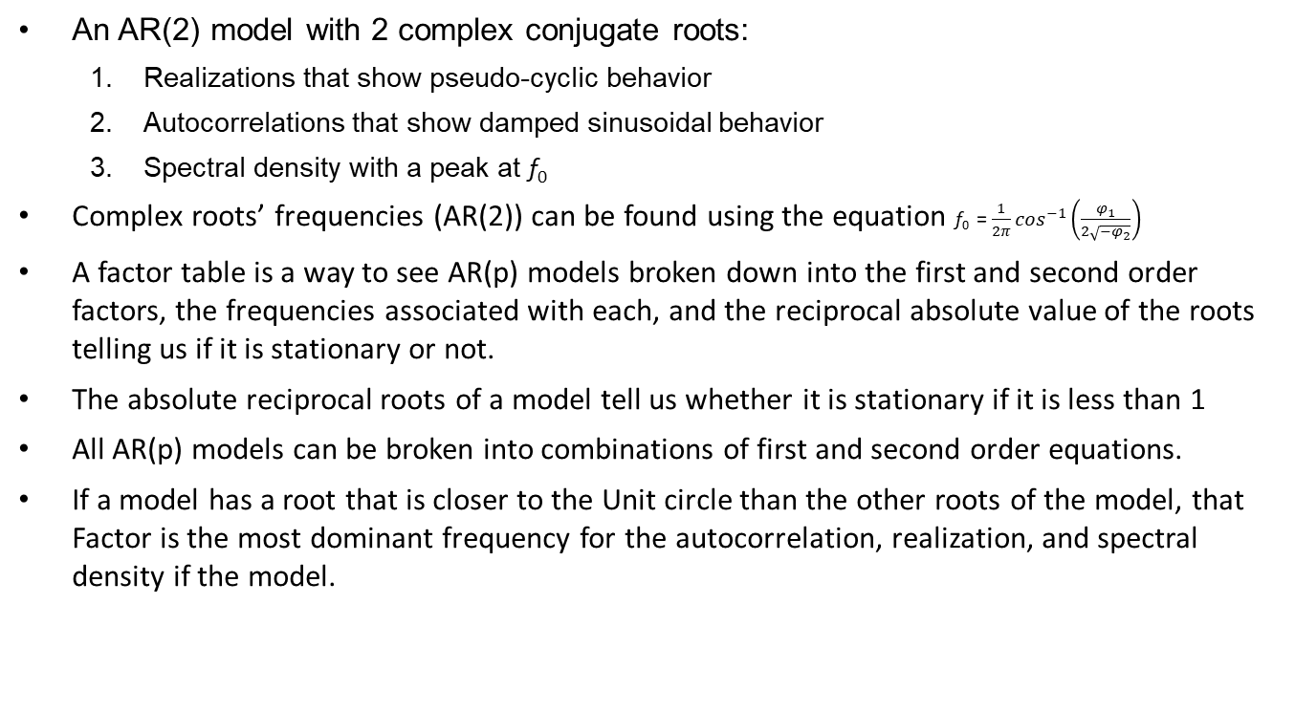
Takeaways from Unit 4
An AR(2) model with 2 complex conjugate roots:
Realizations that show pseudo-cyclic behavior
Autocorrelations that show damped sinusoidal behavior
Spectral density with a peak at f₀
Complex roots’ frequencies (AR(2)) can be found using the equation f₀ = $\frac{1}{2π}\cos^{−1}\left(\frac{φ_{1}}{2\sqrt{−φ_{2}}}\right)$
A factor table is a way to see AR(p) models broken down into the first and second order factors, the frequencies associated with each, and the reciprocal absolute value of the roots telling us if it is stationary or not.
The absolute reciprocal roots of a model tell us whether it is stationary if it is less than 1
All AR(p) models can be broken into combinations of first and second order equations.
If a model has a root that is closer to the Unit circle than the other roots of the model, that Factor is the most dominant frequency for the autocorrelation, realization, and spectral density if the model.

Slide 15
Questions from Unit 4
Looking at the for live session, I’m not sure how to compare a model to a dataset and say “This is the best model for the dataset” other than looking at their respective spectral densities and autocorrelations and making a judgment. I know we can do something like RMSE or ASE between the two but I am not sure how to do that yet. I hope we go over this in class!

Slide 16
UNIT 5

Slide 17
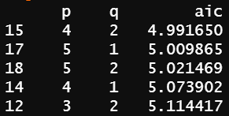
For Live Session – Slide 1
Aic5 for the Walmart data:
aic5.wge(stor9_item50$sales)
Lowest AIC, so ARMA(4,2) would fit the data the best

Slide 18
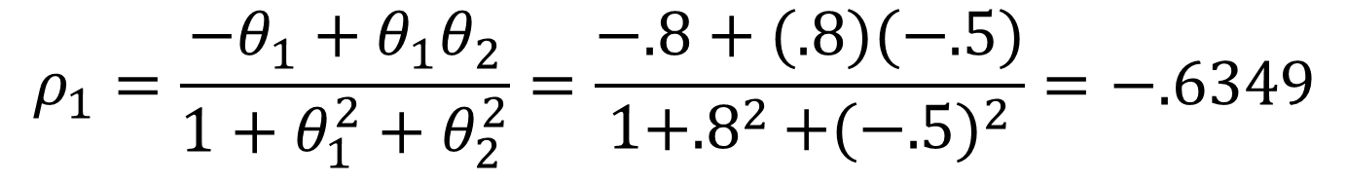
For Live Session – Slide 2
Find p1 for Xt = at-.8at-1 + .5at-2:
$$ρ_{1}=\frac{−θ_{1}+θ_{1}θ_{2}}{1+θ_{1}^{2}+θ_{2}^{2}}=\frac{−.8+(.8)(−.5)}{1+{.8}^{2}+{(−.5)}^{2}}=−.6349$$

Slide 19

For Live Session – Slide 3
Represent Xt = at-.8at-1 + .5at-2 in GLP form
$$MA\left(2\right): X_{t}=a_{t}+.8a_{t−1}+−.5a_{t−2 }$$

Slide 20
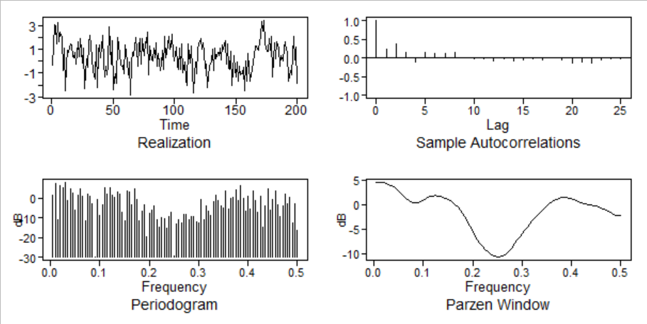
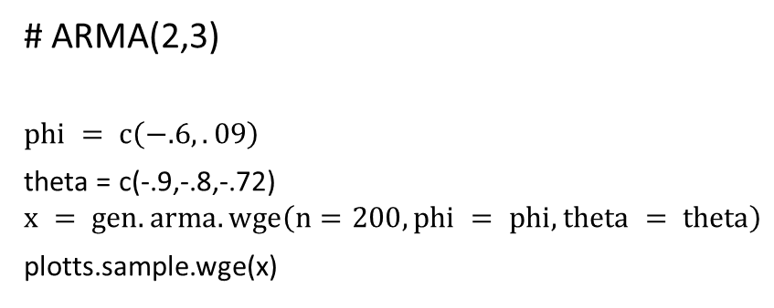
For Live Session – Slide 4
Generate a realization from an ARMA model. Pick p and q and include ACF and spectral density:
# ARMA(2,3)
$$phi = c\left(−.6,.09\right)$$
theta = c(-.9,-.8,-.72)
$$x = gen.arma.wge\left(n=200, phi = phi, theta = theta\right)$$
plotts.sample.wge(x)

Slide 21
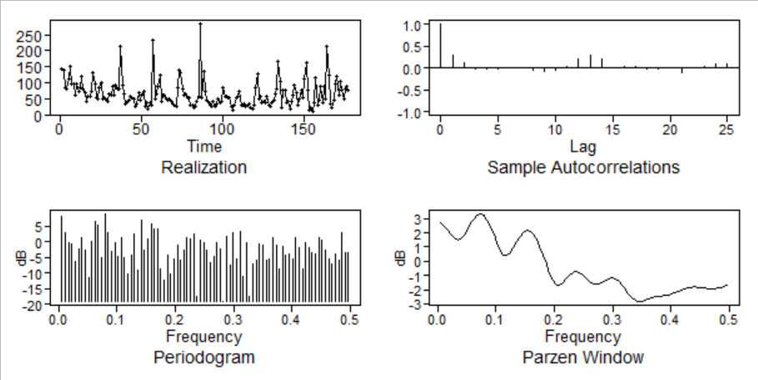
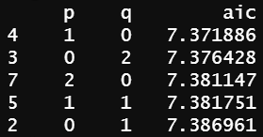
For Live Session – Slide 5
Use Aic5 to identify the top 5 quality models with respect to AIC for the cancelled flight data from the SWADelay.csv. Comment on which are AR, MA, and ARMA:
plotts.sample.wge(SWA$arr_cancelled)
aic5.wge(SWA$arr_cancelled)
AR(1)
MA(2)
AR(2)
ARMA(1,1)
MA(1)

Slide 22
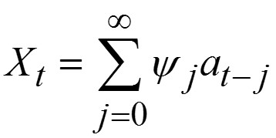
Takeaways from Unit 5
An MA(q) = ARMA(0,q)
An AR(p) =ARMA(p,0)
ARMA models that are both stationary and invertible can be written in
GLP form
Infinite order AR model
MA(q) models are not as useful as AR(p) models however when combined with MA(p) models to create ARMA models they are helpful.
To calculate psi weights of an MA(q) model:
MA(1) models the spectral densities have dips instead of peaks with a max of 0.5.
2 different MA models could have the same autocorrelations which is unwanted. However only one of those MA models can be invertible, meaning the roots of the MA characteristic equation are greater than 1 in absolute value.
ARMA models can have like terms on each side of the equal sign, in which case like terms would cancel out and leave some variation of an AR or MA model only.
Given a set of data, the AIC is used to evaluate and compare the quality of models. The model with the lowest AIC is thought to have the most quality

Slide 23
Questions from Unit 5
I am very interested in Stock analysis (specifically crypto if that matters) and have used moving averages in the past to judge short term movement. But I don’t understand how this unit applies to stuff like that. I’m not making the connection. Could you explain how it would work in the stock world in class?

Slide 24
UNIT 6

Slide 25
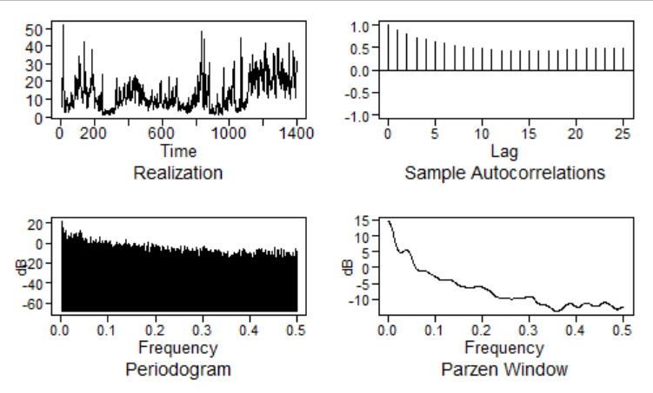
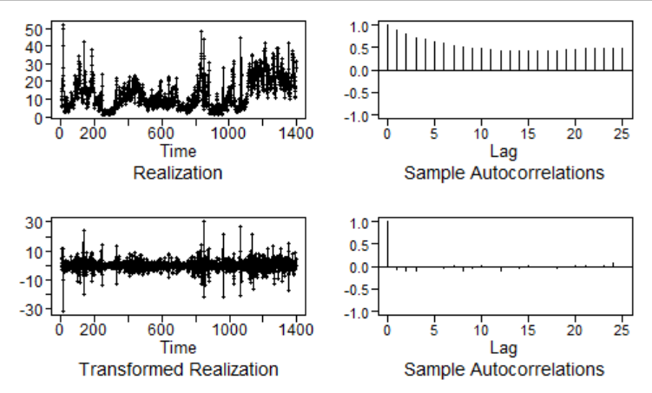
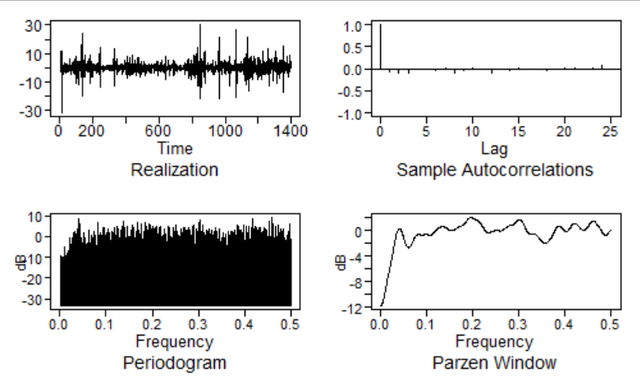
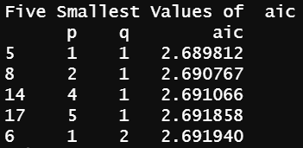
For Live Session – Slide 1
Look at data from week 1
Original realization:
dif1 = artrans.wge(milan, phi.tr = 1)
Differenced Data:
plotts.sample.wge(dif1)
Differenced Data plotted:
The differenced data seems like it’s white noise, so an ARIMA(0,1,0) might be best for it. There are peaks present within the spectral density so it could be AR and MA elements present. If we look at the AIC it could be that the best model would be ARIMA(1,1,1) as well.
aic5.wge(dif1)
Differenced Data:

Slide 26
For Live Session – Slide 2
Factor Table for seasonal model with s=7
Coefficients of Original polynomial:
0.0000 0.0000 0.0000 0.0000 0.0000 0.0000 1.0000
Factor Roots Abs Recip System Freq
1-1.0000B 1.0000 1.0000 0.0000
1+0.4450B+1.0000B^2 -0.2225+-0.9749i 1.0000 0.2857
1-1.2470B+1.0000B^2 0.6235+-0.7818i 1.0000 0.1429
1+1.8019B+1.0000B^2 -0.9010+-0.4339i 1.0000 0.4286
$$s = 7; factor.wge(c(rep(0,s−1), 1))$$

Slide 27
For Live Session – Slide 3
Part A
(1 - B^4)Xt = (1 + 0.3B)(1 - 0.6B + 0.8B^2)at
(1 - B^4) -> s = 4
There are no (1-B)^d term -> d = 0
There is no dependence on X with lag, hence there are no AR components -> p = 0
There are 3 roots in the characteristic equation for the MA side -> q = 3
Therefore, this is a seasonal ARUMA model with d = 0, s = 4, p = 0 and q = 3

Slide 28
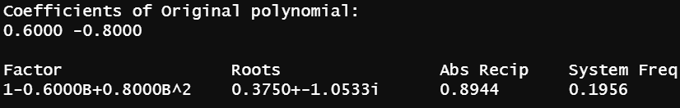
For Live Session – Slide 3
Part B
(1 + 0.3B)Xt = (1 - 0.6B + 0.8B^2)at
theta = c(0.6, -0.8)
factor.wge(phi = theta)
There are no seasonal (1-B^s) terms -> s = 0
There are no (1-B)^d term -> d = 0
There is 1 root of the characteristic equation of the AR side.
There are 2 roots of the characteristic equation of the MA side (No factors cancel on either side) -> -> p = 1, q = 2
This is a ARMA(1,2) model

Slide 29
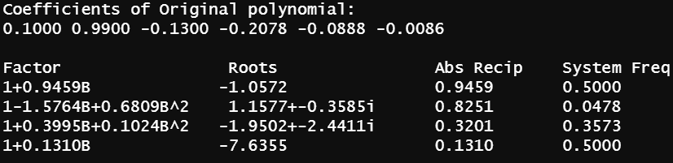
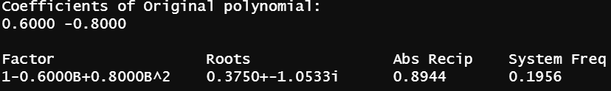
For Live Session – Slide 3
Part B
(1 - 0.1B - 0.99B^2 + 0.013B^3 + 0.2078B^4 + 0.0888B^5 + 0.00864B^6) * (1-B)^2 * (1-B^12) * Xt = (1 - 0.6B + 0.8B^2)at
phi = c(0.1, 0.99, -0.13, -0.2078, -0.0888, -0.00864)
factor.wge(phi = phi)
theta = c(0.6, -0.8)
factor.wge(phi = theta)
There is a seasonal component (1-B^s) -> s = 12
There is a (1-B)^d term -> d = 2
There are 6 roots of the characteristic equation of the AR side. There are 2 roots of the characteristic equation of the MA side (and none of the factors on the AR and MA side cancel) -> p = 6, q = 2
This is a Seasonal ARUMA model with p = 6, d = 2, q = 2 and s = 12

Slide 30
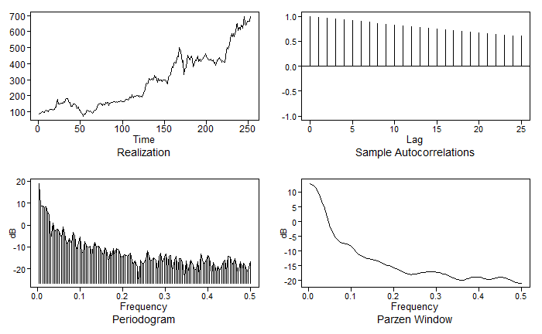
For Live Session – Slide 4 (TSLA)
Pick a stock and download the last year’s worth of daily stock price data.
Plot the data
Take the first difference, and the estimate the structure of the differenced data.
From this information, suggest a model for the data.

Slide 31
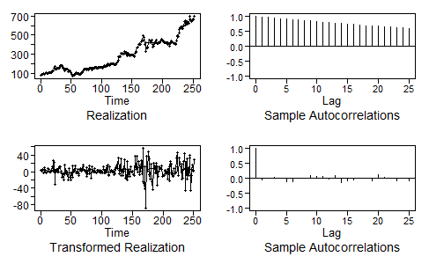
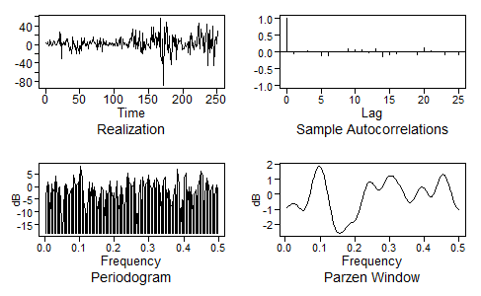
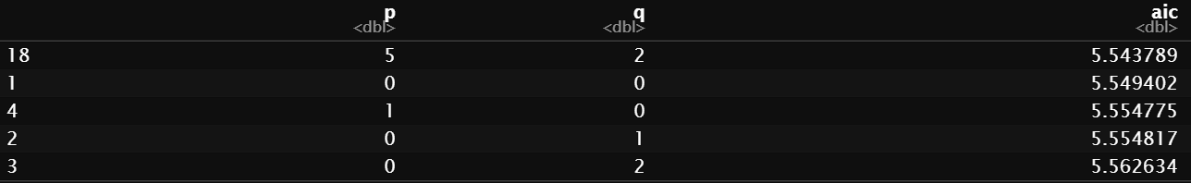
For Live Session – Slide 4 (TSLA)
Pick a stock and download the last year’s worth of daily stock price data.
Take the first difference, and the estimate the structure of the differenced data.
From this information, suggest a model for the data.
Differenced Data
Plotts.sample.wge of differenced data
This is hard to say, the differenced data looks like it is white noise I believe. ARIMA(0,1,0) might fit it, however the AIC shows ARMA(5,2) with the lowest AIC but ARMA(0,0) as not too much further behind. It could be ARIMA(0,1,0) or ARIMA(5,1,2) perhaps?

Slide 32
Takeaways from Unit 6
An ARIMA model is a process where the differences of the coefficients can satisfy the requirements for a stationary ARMA model.
ϕ(B)(1−B) ^{d} Xt = θ(B)at
All the roots of ϕ(B) and θ(B) are outside the unit circle
d is a non-negative integer
Differences of (1−B) ^{d}Xt satisfy a stationary model (ARMA)
ARIMA Models are non-stationary because the variance is not finite.
The (1 − B)^{d} factor dominates the stationary components.
In the realizations
Autocorrelations
Spectral densities all have peaks at f = 0
AN ARUMA Model is a generalization of an ARIMA model better for Seasonal Data
ϕ(B)(1−B)^{d}(1−B^{s})Xt=θ(B)at
All the conditions from ARIMA are met
s is a non-negative integer
ARUMA really is a more general model than the combination of ARIMA with seasonality. It includes any model with additional non-stationary factors that do not form seasonal or integrated forms.

Slide 33
Questions from Unit 6
Do we expect to see seasonality in stock data? Perhaps if it is a stock that pays dividends quarterly? Or is that generally not how stock analysis uses modeling?

Slide 34
UNIT 7

Slide 35
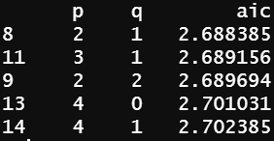
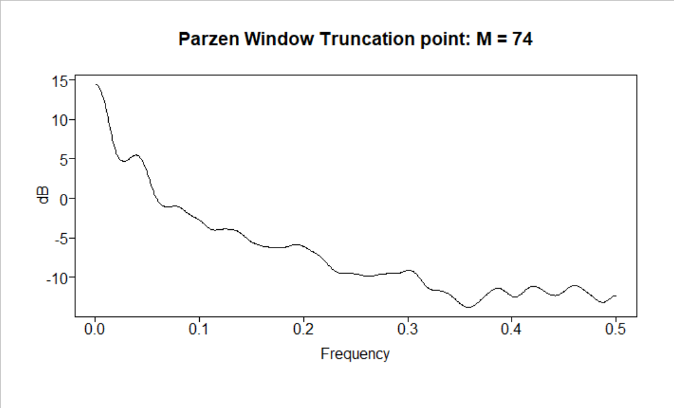
For Live Session – Slide 1
Which model do you think is appropriate to use to forecast your time series? Why?
Aic5: According to Aic5, the best suited model for the milan data would be ARMA(2,1) with an AIC of 2.688385
Appropriate model to forecast:
Well Aic5 seems to believe ARMA(2,1) is best, and I tend to lean that way as well however there is some noise present within the realization. It could be that an ARUMA(2,1,1) would forecast the data better with s=20 (spectral density peak at .05)
aic5.wge(milan) :
Spectral density:

Slide 36
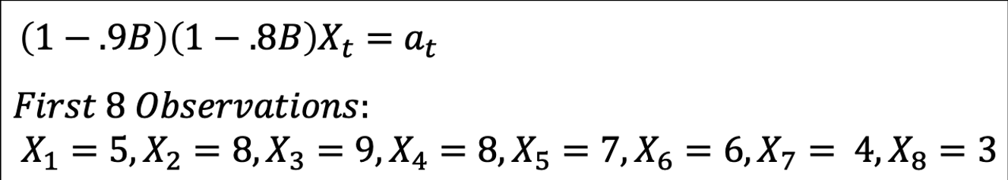
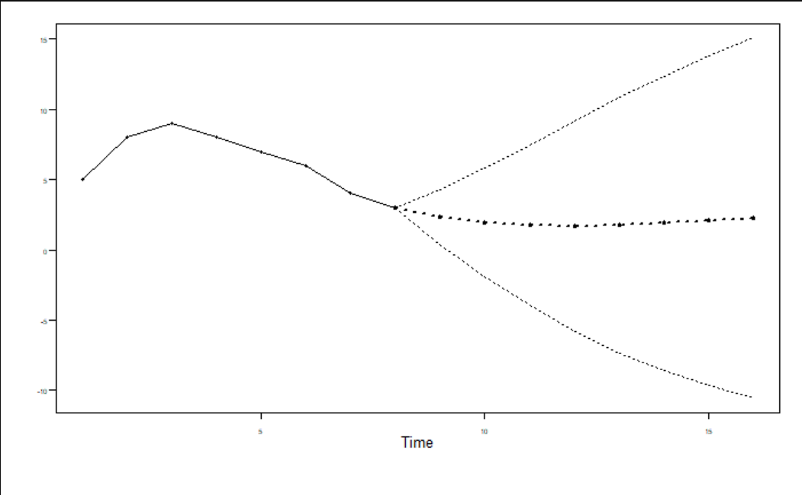
For Live Session – Slide 2
Find the first 5 psi weights for the model below and use them to find the half-width of the 95-percentile probability interval for the third forecast (Xhat(3)). Please show your work as well as a plot of the series and the first eight forecasts with probability intervals.
multfac = mult.wge(fac1 = 0.9, fac2 = 0.8)
phi = multfac$model.coef
weightsPSI = psi.weights.wge(phi = phi, lag.max = 5)
print(weightsPSI)
l = 3
# 95% interval of X_t0(3) needs lags l-1
multiplier = 1.96 * sqrt(1 + sum(weightsPSI[1:l-1]^2))
cat(multiplier)
x = c(5, 8, 9, 8, 7, 6, 4, 3)
f = fore.arma.wge(x, phi = phi, n.ahead = 3, limits = TRUE)
whitenoisevar = f$wnv
cat(whitenoisevar)
halfwidth = sqrt(whitenoisevar) * multiplier
cat(halfwidth)
n.ahead = 8
f = fore.arma.wge(x, phi = phi, n.ahead = 8, limits = TRUE)

Slide 37
For Live Session – Slide 3 (part 1)
Using the three models attached in the powerpoint at the bottom and the Amtrak ridership data, which model has the smallest ASE in forecasting the next year (12 months)? Show your code in forecasting the 12 observations as well as in calculating the ASE.
n = nrow(amtrak)
n.ahead = 12
amtrak = amtrak$Ridership
#keep track of results across all models
results = tribble(~model, ~ASE)

Slide 38
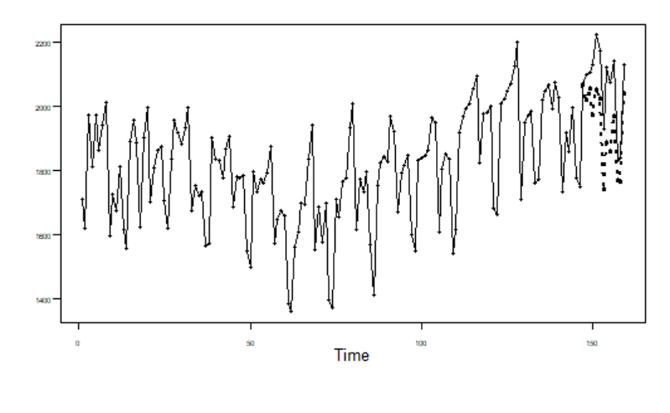
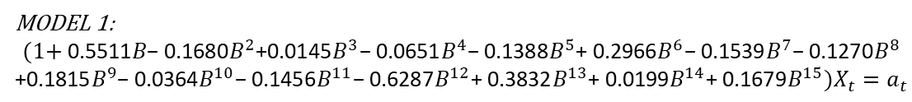
For Live Session – Slide 3 (part 2)
Model 1
MODEL 1:
$$(1\text{+ }\text{0.5511}B\text{− 0.1680}B^{2}\text{+0.0145}B^{3}\text{− 0.0651}B^{4}\text{− 0.1388}B^{5}\text{+ 0.2966}B^{6}\text{− 0.1539}B^{7}\text{− 0.1270}B^{8}$$
$$\text{+0.1815}B^{9}\text{− 0.0364}B^{10}\text{− 0.1456}B^{11}\text{− 0.6287}B^{12}\text{+ 0.3832}B^{13}\text{+ 0.0199}B^{14}\text{+ 0.1679}B^{15})X_{t}=a_{t}$$
phis: c(0.5511, 0.1680, -0.0145, 0.0651, 0.1388, -0.2966, 0.1539, 0.1270, -0.1815, 0.0364, 0.1456, 0.6287, -0.3832, -0.0199, -0.1679)
phi = c(0.5511, 0.1680, -0.0145, 0.0651, 0.1388, -0.2966, 0.1539, 0.1270, -0.1815, 0.0364, 0.1456, 0.6287, -0.3832, -0.0199, -0.1679)
theta = 0
f = fore.arma.wge(amtrak, phi=phi, theta = theta, n.ahead=n.ahead, limits=FALSE, lastn = TRUE)
ase = mean((amtrak[(n-n.ahead+1):n] - f$f)^2)
ase
results = results %>% add_row(model = "Model 1", ASE = ase)

Slide 39
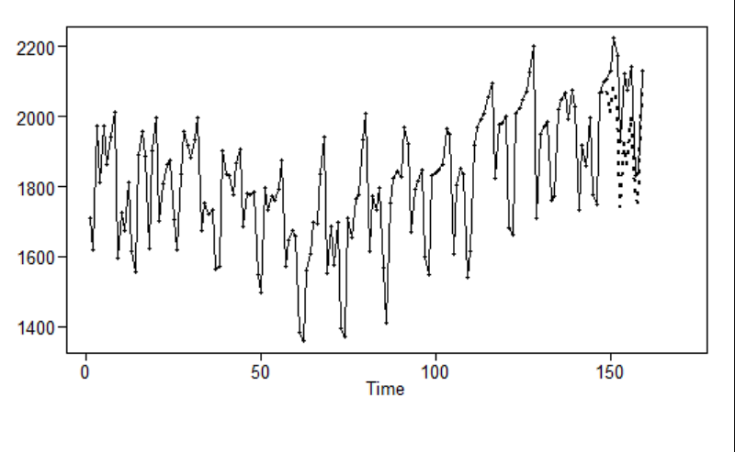
For Live Session – Slide 3 (part 3)
Model 2
$$MODEL 2:$$
$$(1\text{+ }\text{0.027}1B\text{−0.7421}B^{2})(1−B^{12})X_{t}={(1\text{+ }\text{0}.5845B\text{− }0.3837B^{2})a}_{t}$$
phis: c(-0.02709541, 0.74213105)
thetas: c(-0.5844596, 0.3836931)
phi = c(-0.02709541, 0.74213105)
theta = c(-0.5844596, 0.3836931)
f = fore.aruma.wge(amtrak, phi=phi, theta = theta, s = 12, n.ahead = n.ahead, limits=FALSE, lastn = TRUE)
ase = mean((amtrak[(n-n.ahead+1):n] - f$f)^2)
ase
results = results %>% add_row(model = "Model 2", ASE = ase)

Slide 40
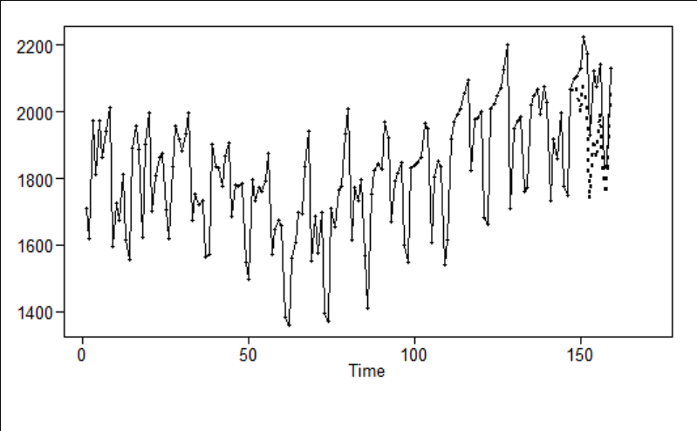

For Live Session – Slide 3 (part 4)
Model 3
$$MODEL 3:$$
$$(1 − .3069B)(1−B)(1−B^{12})X_{t}={(1\text{− }0.7432B)a}_{t}$$
phi: 0.306943
theta: 0.7431719
phi = c(0.306943)
theta = c(0.7431719)
f = fore.aruma.wge(amtrak, phi=phi, theta = theta, d = 1, s = 12, n.ahead = n.ahead, limits=FALSE, lastn = TRUE)
ase = mean((amtrak[(n-n.ahead+1):n] - f$f)^2)
ase
results = results %>% add_row(model = "Model 3", ASE = ase)

Slide 41
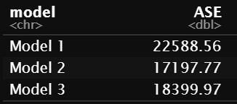
For Live Session – Slide 3 (part 4)
Results
Model 2 has the lowest AIC, followed by Model 3 and then Model 1

Slide 42

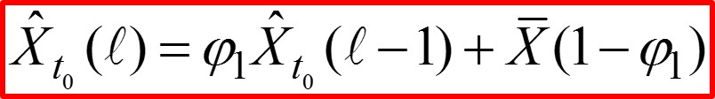
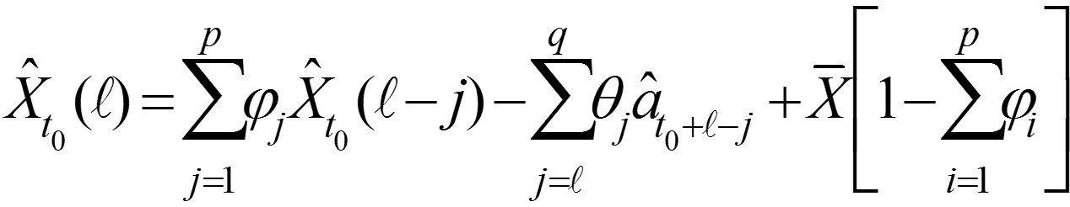

Takeaways from Unit 7
Forecasting is extrapolating
Deterministic Signal-Plus-Noise
S_{t} is a deterministic signal
Z_{t} is a zero-mean, stationary process
Forecasting strategy
${\hat{X}}_{t0}\left(l\right) is the forecast of X_{t0+l}$
$So {\hat{X}}_{10}\left(2\right) is the forecast of X_{12}$
t₀ is the forecast orgin
$l$ is the lead time, the steps ahead we want to forecast
Forecasting formula for AR(1)
Forecasting formula for AR(p)
Forecasting for ARMA(p,q)

Slide 43
Questions from Unit 7
Weights are giving me trouble as well as knowing from raw data given to you how to find out the best model to use in order to forecast? I’m not sure why I couldn’t understand this (along with confidence interval understanding)

